Slide 1

Skills and Competencies Development Program
Nexus Logistics Solutions
Dipita Dia Biswas

Slide 2
Table of contents
Project Mandate
Performance Analysis
01
04
Overview
Proposed Initiatives
02
05
Participation Rate Analysis
03

Slide 3
Project Mandate
The Nexus Logistics Solutions (NLS) proposed to utilize historical course enrollment data to gain comprehensive insights into the utilization of the Skills & Competencies Development Program. The utilization of the courses can be analyzed by:
Trends in Courses and Regional Participation
Performance Highlights by Local Office
Assessing Course Effectiveness
Regional Analysis of Improvement Scores
This initiative will drive data-driven decision-making for optimizing employee training, identifying best practices, and ensuring skill development aligns with the organization’s strategic objectives.
Project Mandate
Overview
Participation Analysis
Performance Analysis
Proposed Initiatives

Slide 4

Overview
Participation Rate
Performance
Latin America
stands as the leading region in enrolment with
Logistics Software Essentials Course
ranks as the most popular
training program with
3,663
employees enrolled in the course.
Supply Chain
Optimization
Strategy Course
53.7%
of its employee enrolled in courses
has the highest improvement score
Latin America
North America
Asia
Europe
Best Local Office
(based on participation)
Medellin
San Francisco
Hong Kong
Vienna
62.9%
53.4%
42.8%
40.9%
Project Mandate
Overview
Participation Analysis
Performance Analysis
Proposed Initiatives

Slide 5
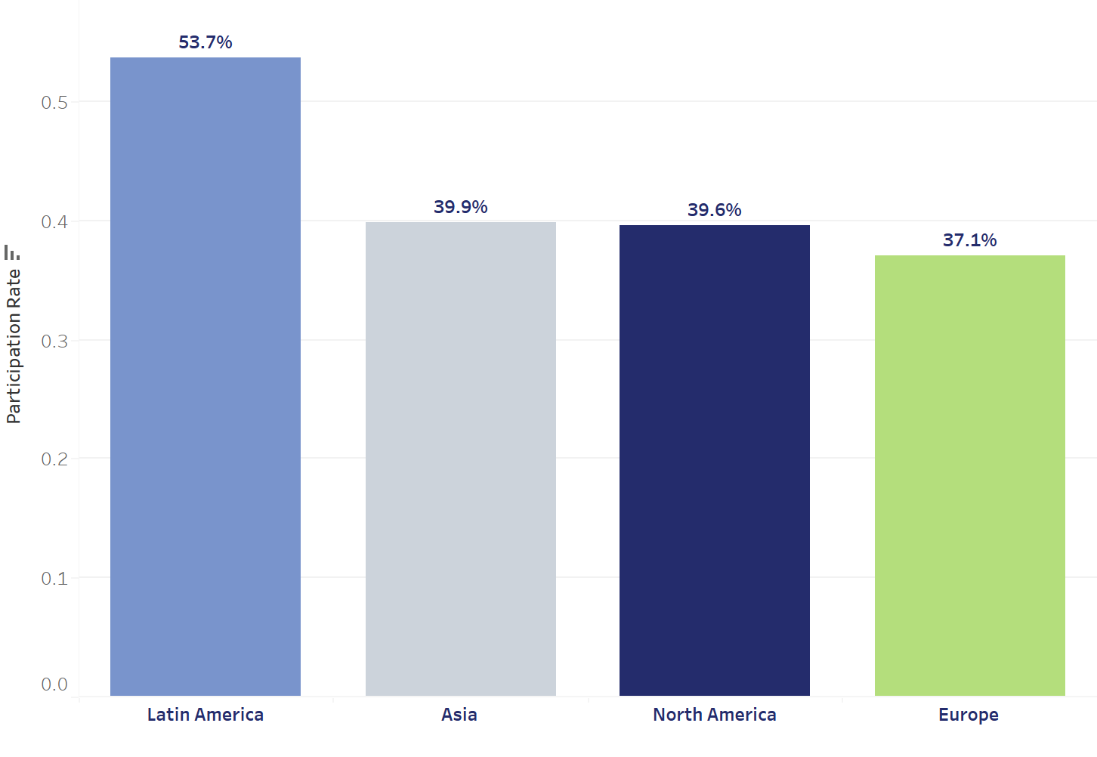
Latin America leads highest enrolment with 53.7%
Latin America has the highest training participation rate of 53.7%.
The remaining regions have a participation rates of around 39-37%.
This suggests that Latin America can be used as a best practice model across the organization.
% participation rate per region
Project Mandate
Overview
Participation Analysis
Performance Analysis
Proposed Initiatives
Notes:
Highest training participation rate: Latin America
The rest: around 37-39%
=> Best practice , can implemented across the organization

Slide 6
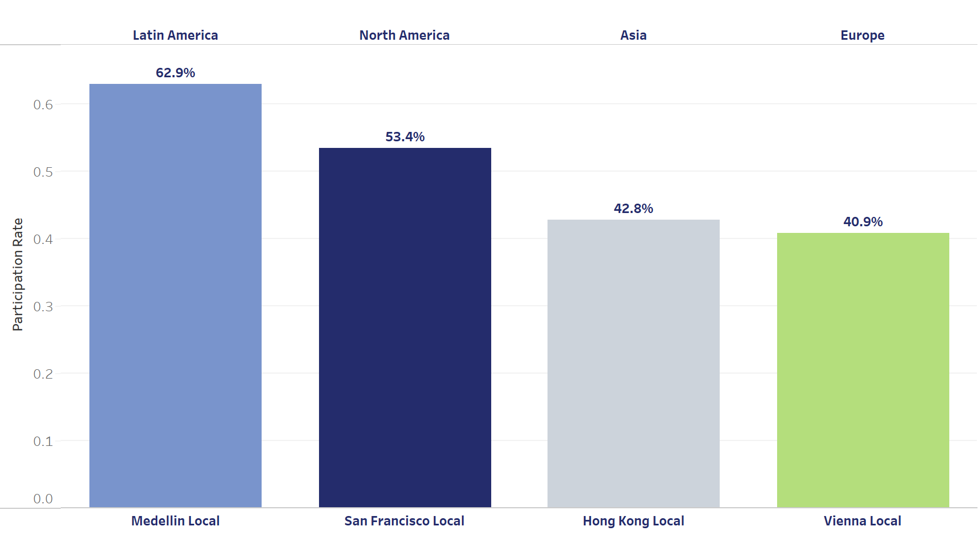
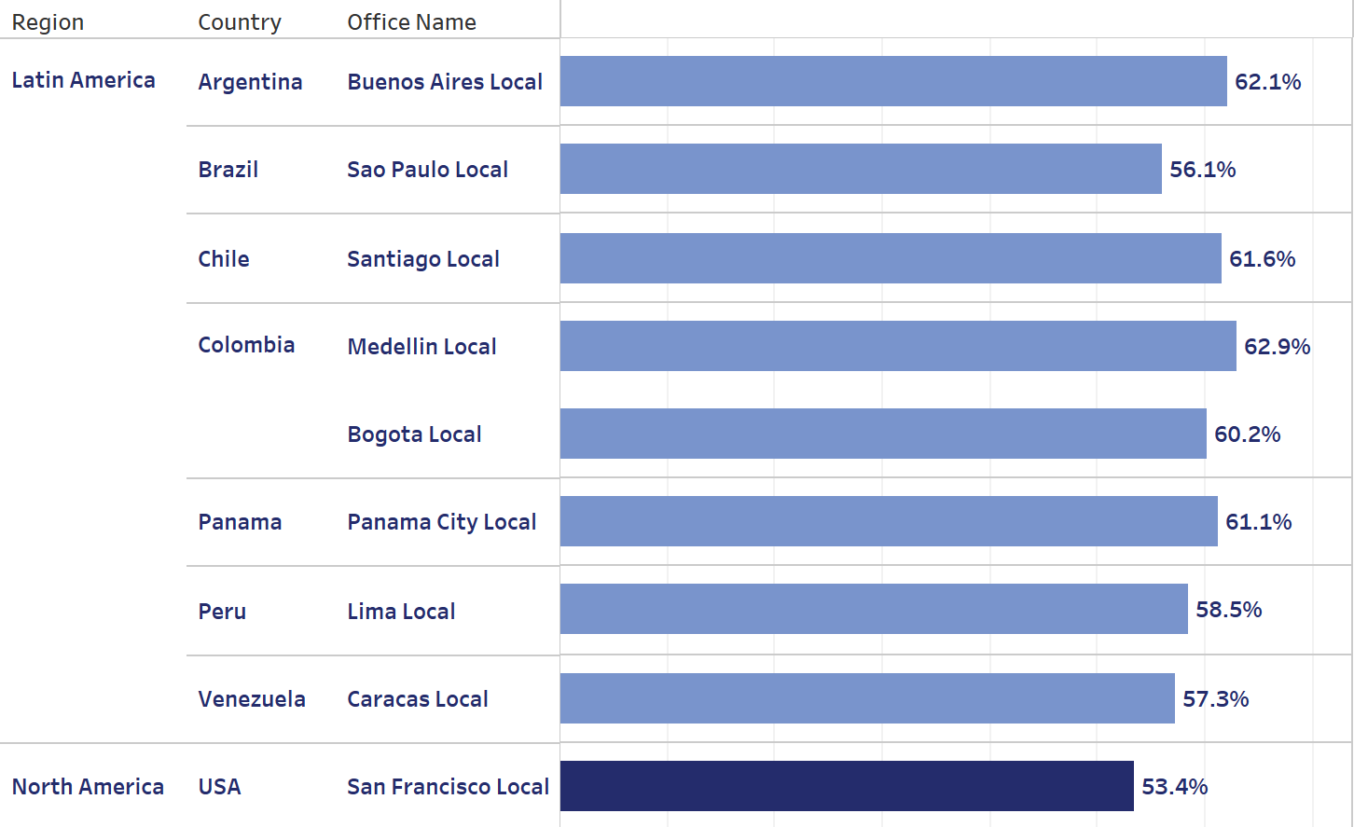
Medellin Local Office has highest participation rates
Highest % participation rate per local office per region
More than 50 % participation rate in local offices across regions
Even the highest participation local offices in Asia and Europe have a participation level of less than 50% which suggests there is a discrepancy.
A comprehensive assessment will help to identify areas of improvement specifically for these two regions.
8 out of 12 Latin American local offices exceed 50% engagement, indicating effective strategies in this region. This suggests that employees working in Latin America are more likely to enroll in the training course.
Only the San Francisco office from North America exceeds the 50% threshold.
Project Mandate
Overview
Participation Analysis
Performance Analysis
Proposed Initiatives

Slide 7
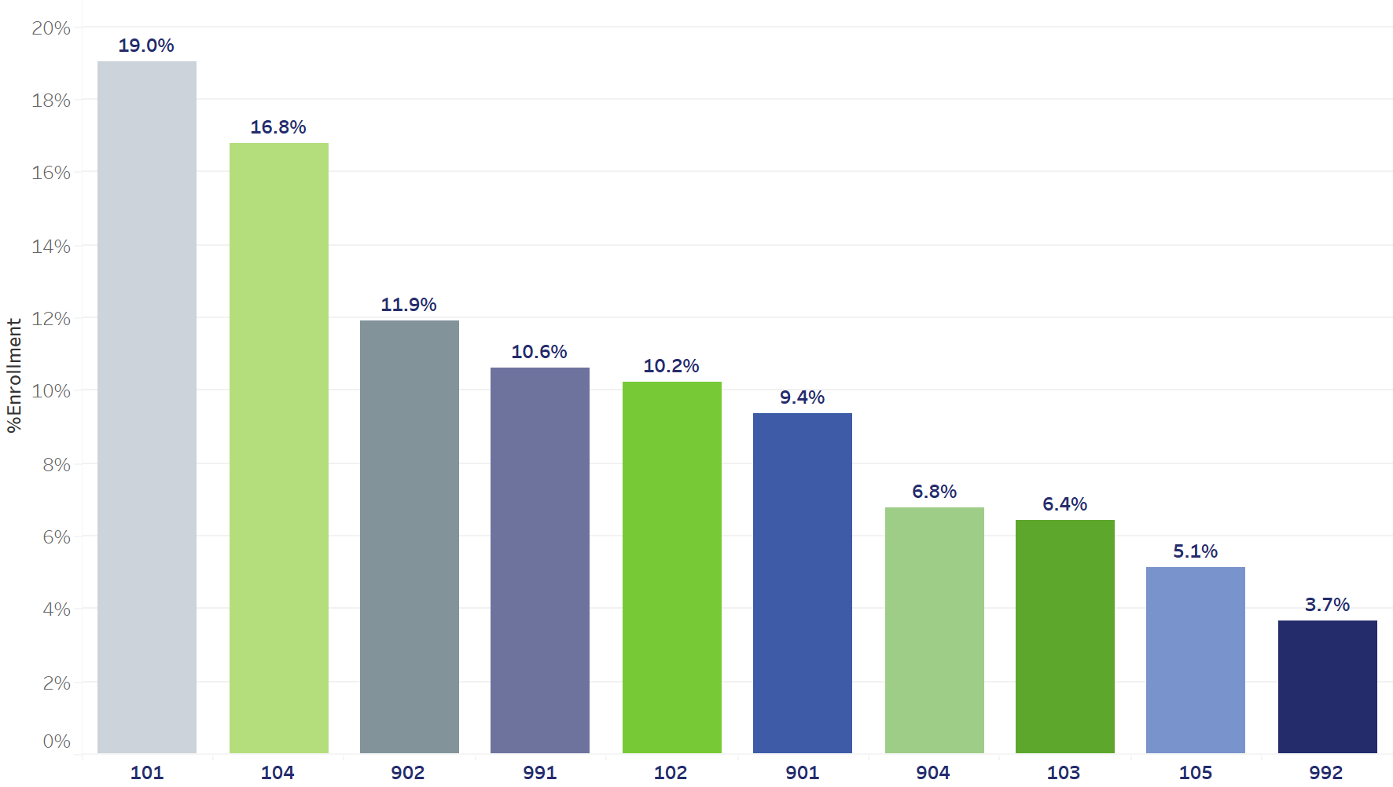
Logistics Software Essentials is the most demanded course with 3663 Enrollments
Course 101’s popularity suggests it is highly relevant or essential to a broad range of employees.
However, the fact that a single course commands the majority of participation, indicates a lack of diversity in course engagement. Course 104 is for those who have taken Course 101 and want to learn more about it, and this is the reason why they have the higher enrollment rates.
Cybersecurity, while critical, might not be viewed as a core competency for most employees in logistics or supply chain roles.
Cybersecurity is more related with IT department hence the employees from the other departments might feel less interested.
% participation rate per course
Logistics Software Essentials (Course 101) and Advanced Transportation Management System (Course 104) are the two most participated courses, whereas Cybersecurity in Supply Chain Management (Course 992) has the least number of people enrolling.
Project Mandate
Overview
Participation Analysis
Performance Analysis
Proposed Initiatives

Slide 8
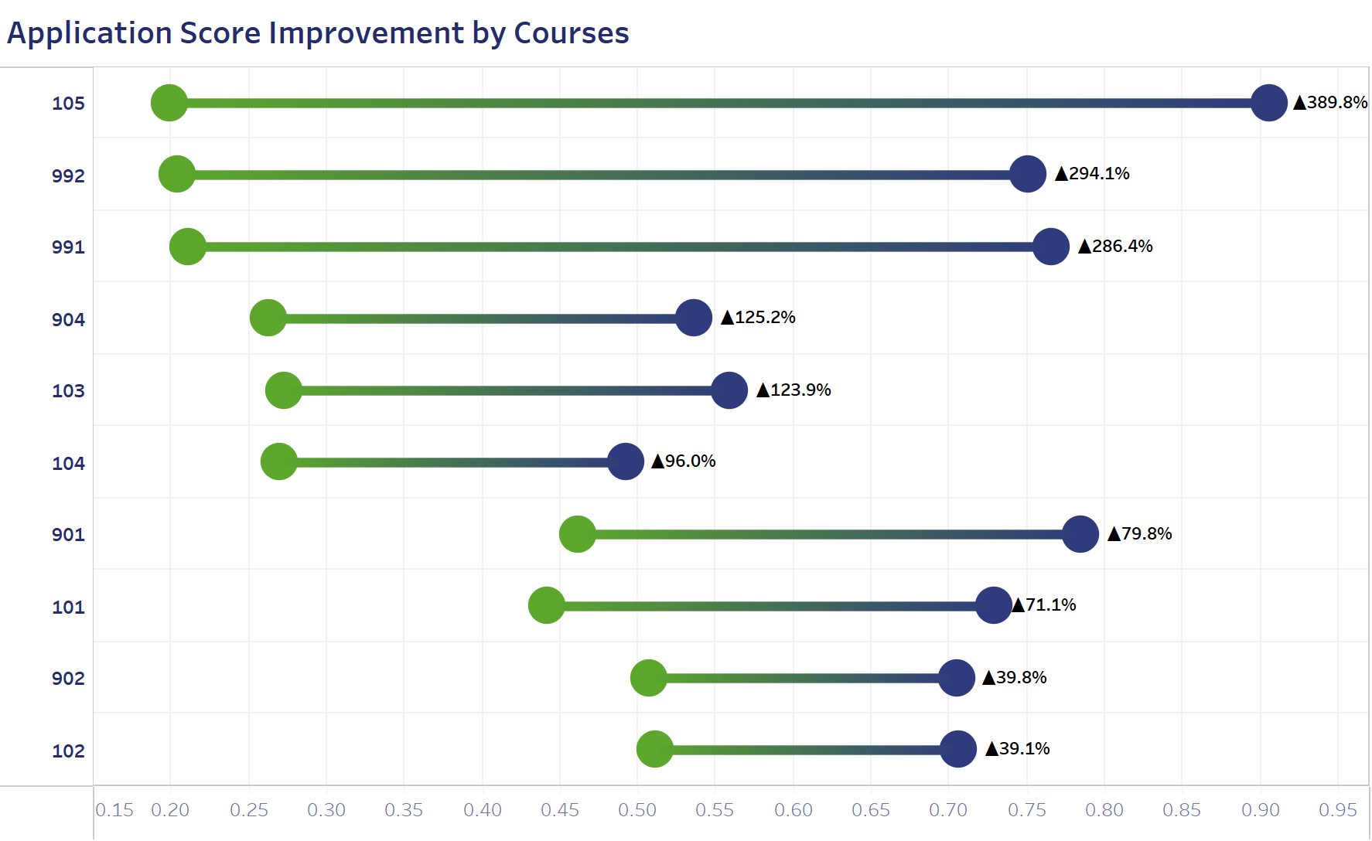
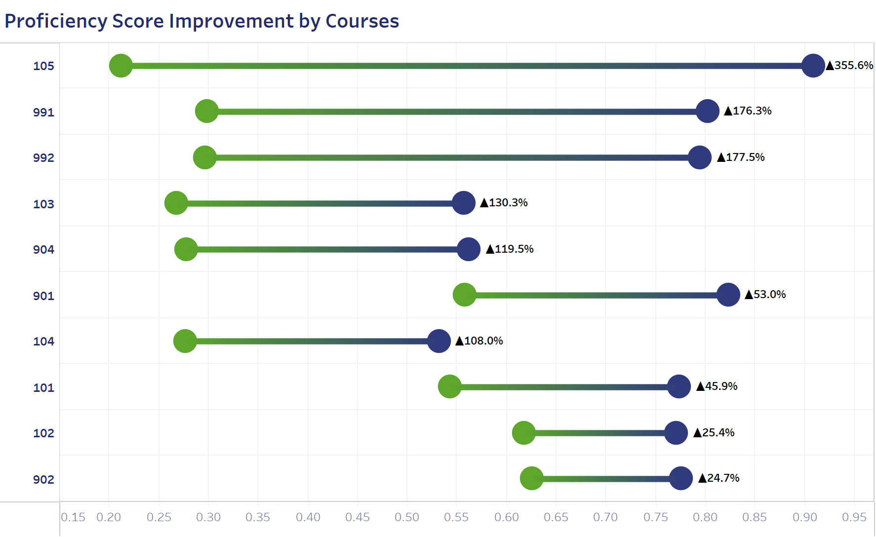
Supply Chain Optimization Strategy course has the highest score improvement rate of over 350%
Course Supply Chain Optimization Strategy stands out significantly, showing the highest improvement in both application scores (389.8%) and proficiency scores (355.6%) which indicates that the content of the course helps the employees to improve their skills and competencies.
Courses Logistics Software Essentials, Intro to NERP, and Intro to NERP - Virtual exhibit the lowest improvements in both application and proficiency scores, which indicates that the content of the course needs to be changed as it does not contribute much in the improvement of the skills of the employees.
Project Mandate
Overview
Participation Analysis
Performance Analysis
Proposed Initiatives

Slide 9
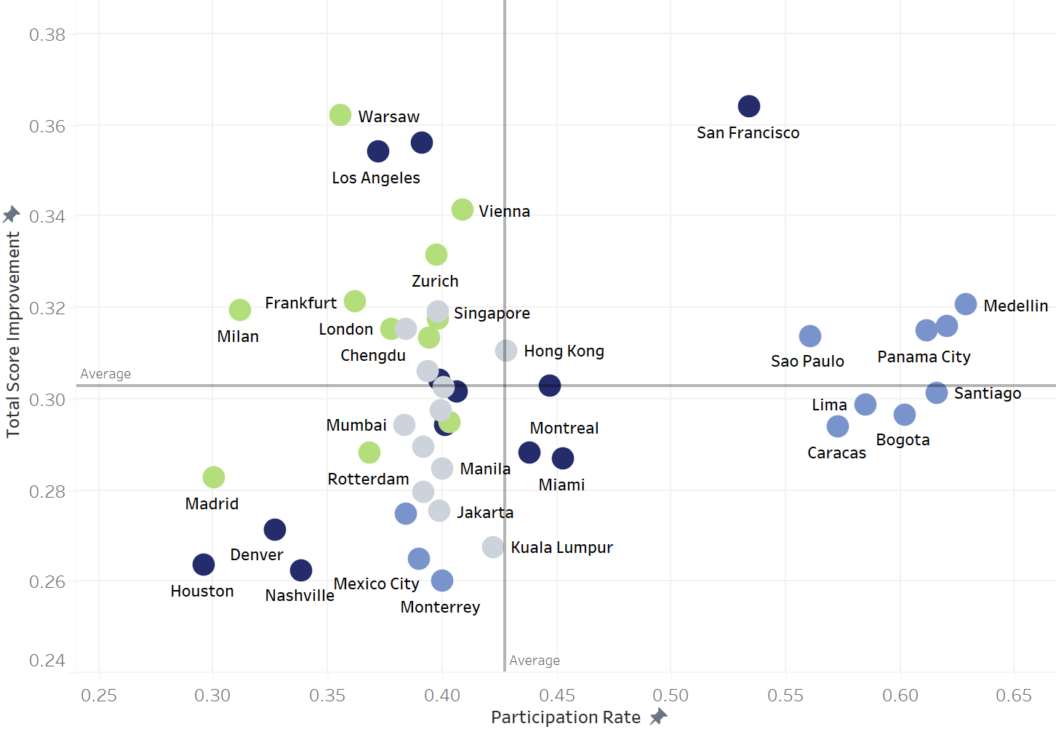
San Francisco leads with high participation rates and score improvements, while Houston lags behind
San Francisco stands out as anomaly with remarkable high engagement level and notable progress, indicating a strong environment of constant learning and development​
A positive correlation between the rate of participation and enhancement in scores.​
However, there are exceptions that suggest participation rate is not the only factor influencing success.​
Warsaw and Los Angeles have made progress despite lower participation levels​\
Lima and Bogota exhibit high engagement but limited improvement
Project Mandate
Overview
Participation Analysis
Performance Analysis
Proposed Initiatives

Slide 10






Proposed initiatives for employee development
Enhance Participation Strategies
Actions
Outcome
Refine course offerings: optimize subjects covered, course modalities and engagement strategies at local office
Increase engagement and relevant of training courses, leading to a better skill development
Best practice identification: pinpoint local offices with high training participation to extract best practices that can be implemented across the organization
Implementation of best practices across regions and local offices, improve overall training effectiveness and provide consistence skills across the organization.
Gap analysis: Detect gaps in the current course offerings to ensure comprehensive skill development opportunities for all employees
Identification and addressing the skill gaps, ensuring the training development program created more skilled and capable workforce
Project Mandate
Overview
Participation Analysis
Performance Analysis
Proposed Initiatives

Slide 11
THANKYOU!!

